Slide 1


Data Science

Slide 2

Basic Data Structures
(ft. Swirl)
Week 3 of 196 (Week 4 of school) :)
Channel: #data_hackerspace

Slide 3

Learn R, in R.
swirl teaches you R programming and data science interactively, at your own pace, and right in the R console!

Slide 4
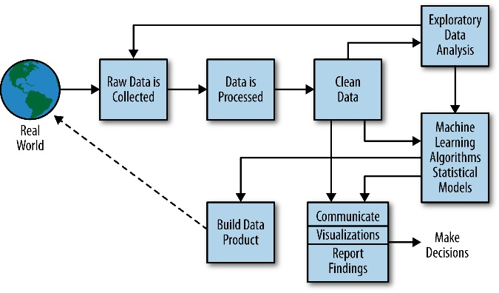

Process of “Data Science”

Slide 5
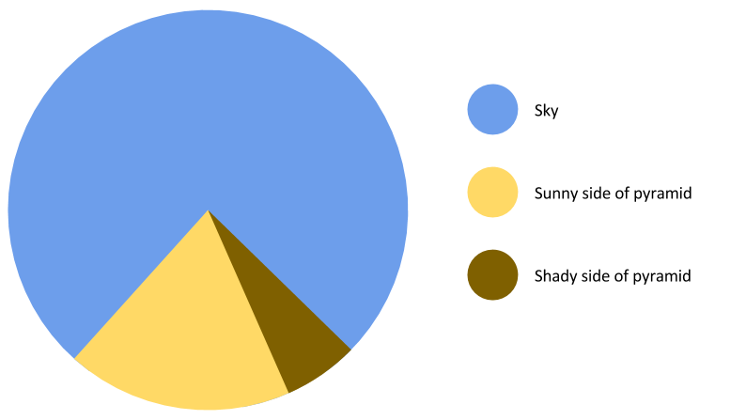
Once Data set is processed and cleaned, we can easily communicate through Data/Visualization.

Slide 6
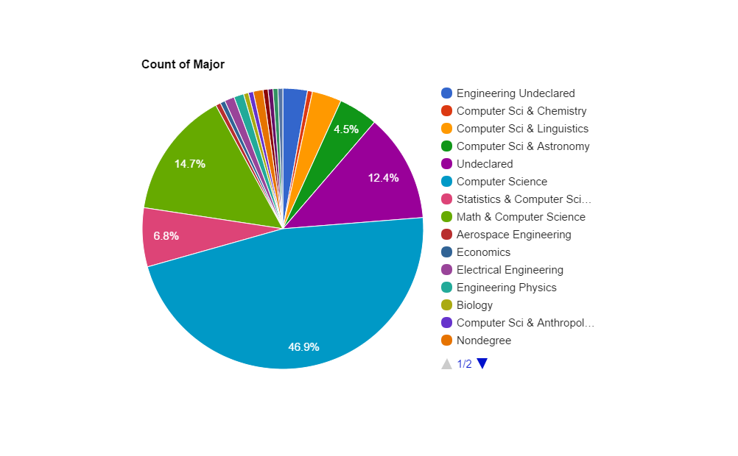
Once Data set is processed and cleaned, we can easily communicate through Data/Visualization.

Slide 7
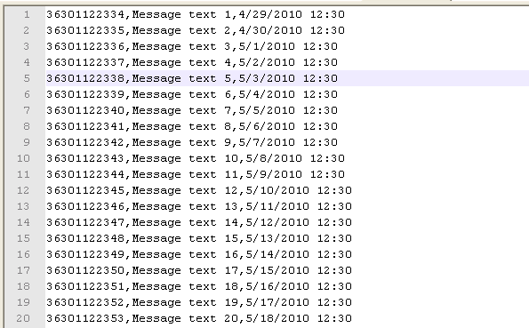
File Types
CSV - Comma Separated Values
Fields separated by a delimiter (a comma)
Rows separated by newlines
In what form do we store Data?
Structured? Unstructured?
Text? Photo? Video?

Slide 8
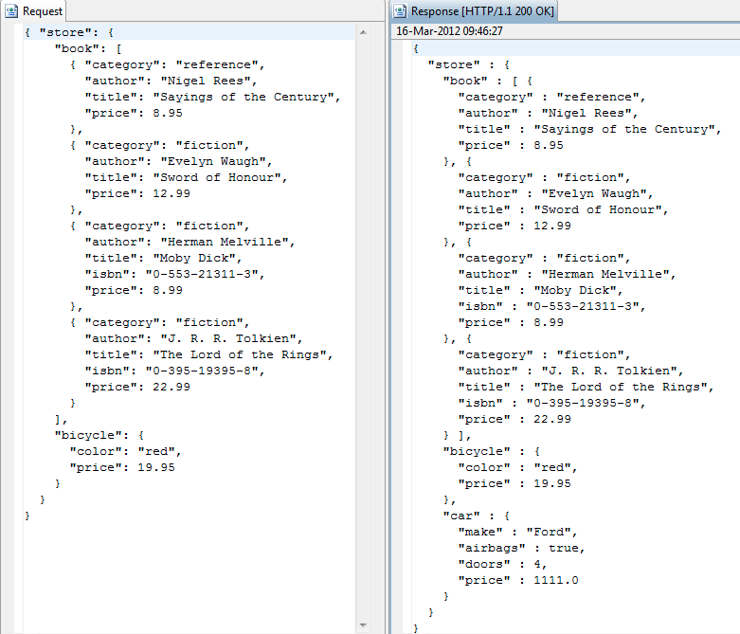
File Types
JSON - JavaScript Object Notation
Supported Data Types:
Number
Boolean
String
Array
Object (Dictionary)
In what form do we store Data?
Structured? Unstructured?
Text? Photo? Video?

Slide 9

Data Parsing + Manipulation
Converting to native data structures
Python has csv, json parsing modules
Selecting fields
I.e. “from phonebook select last_names”
Selecting entries
I.e. “from phonebook select ‘Tyler Kim’”
“Exploration”
Drill down into fields / entries, do simple visualizations, grasp structure of dataset

Slide 10
Jupyter Time
http://bit.ly/besthackerspace

Slide 11

Week 3
Challenge
To Do:
1. Git checkout the Data_Hackerspace repo
Or tinyurl.com/parsethem
2. Mass parse all the json files at once!
(Hint: import glob, os)
3. Print only the “lead_paragraph” section from all 27 json files. Each files has up to 12 of them.
4. Extra Credit if you can do it in less than 5lines
Extra Extra Credit if you can it in less than 3
We’ll have point/leaderboard for each week’s challenge. People with the highest score after week 14 will win something. Prize: TBD
Should you choose to accept… (you should)

Slide 12



